Slide 1

WE CARE HOME CARE
Customer Satisfaction Is Our Priority
MENTOR:
Mr. Suril Patel
PREPARED BY:
Harshil Sheth
Vrunda Savaliya
Vidhi Kapadia

Slide 2
Project Definition
A web-based solution to order/manage home care services (office/home cleaning, washing of rental house, stair cleaning etc.). The customer area should provide online ordering facility of home care services to end user along with management of his/her profile & orders. The admin area should provide easy way to manage customer, services, feedbacks & orders.

Slide 3
Objective
On-demand Home Care Services.
Affordable and flexible
Any time at any place.

Slide 4







Tools And Technology

Slide 5
Modules
ADMIN
USER

Slide 6
WE CARE HOME CARE
Admin
User
Login
Login,Registration
Forget Password
Manage Services
Browse Services
Manage Subservices
Browse Categories
Manage Providers
Add to cart
Place Order
Manage Orders
View Order
Update Profile
Manage Customer
Confirmation Email
View Ratings
Manage Feedback
Give Feedback

Slide 7




Request data using Fetch Api
Send request to process Data
When User clicks on Button
Backend
Database
Processing data in database and send data to backend
HOW OUR APPLICATION WORKS ??
FRONTEND
Send Response in JSON format
Processing Data
RESPONSE
Show Response based on Request
Backend

Slide 8
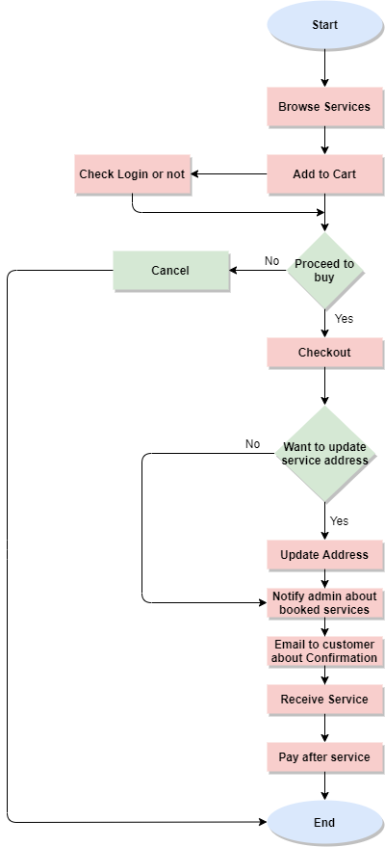
FLOW CHART

Slide 9

Implementation-Quick Demo

Slide 10
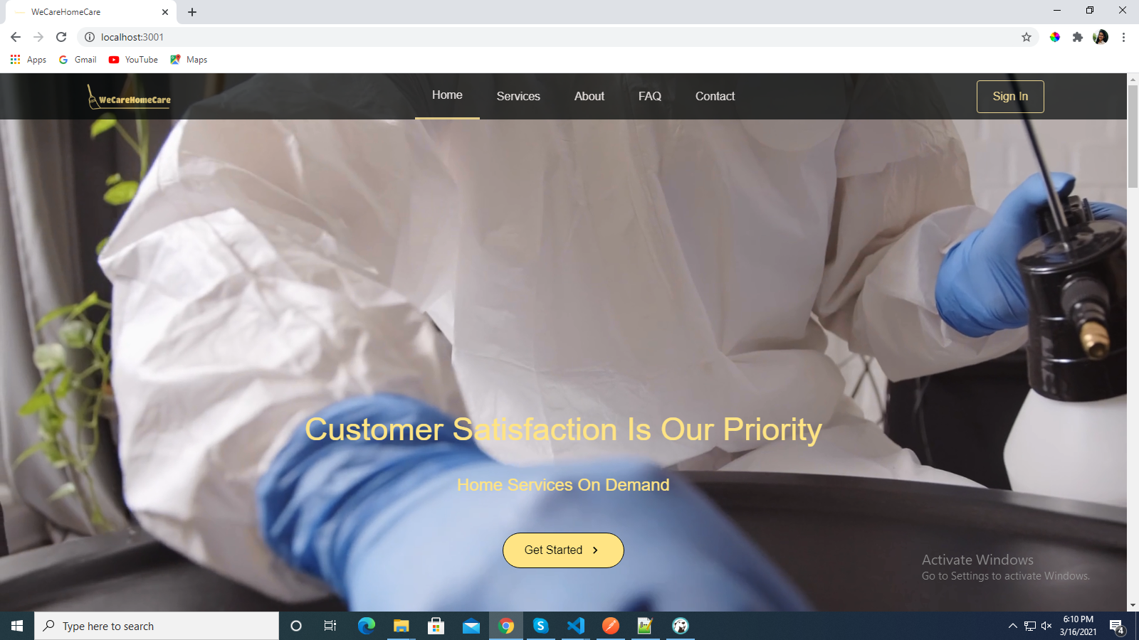
User Dashboard

Slide 11
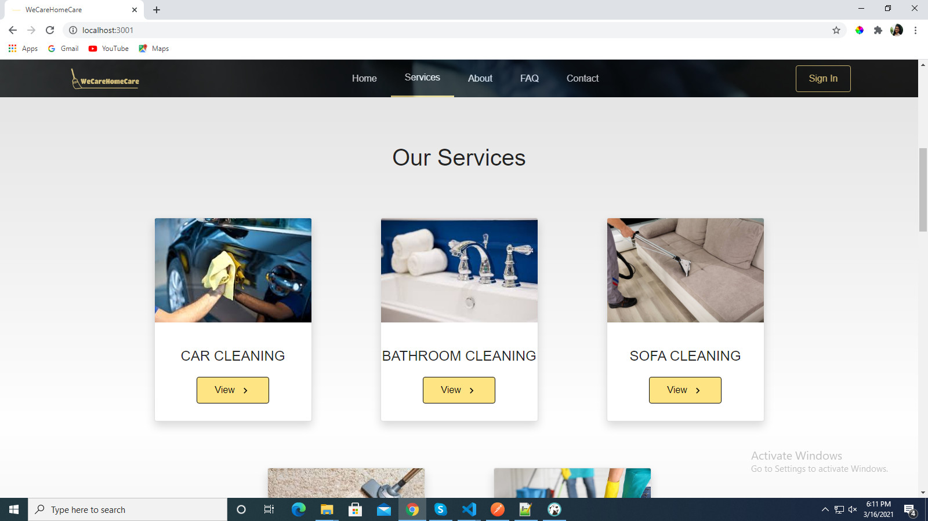
View Services

Slide 12
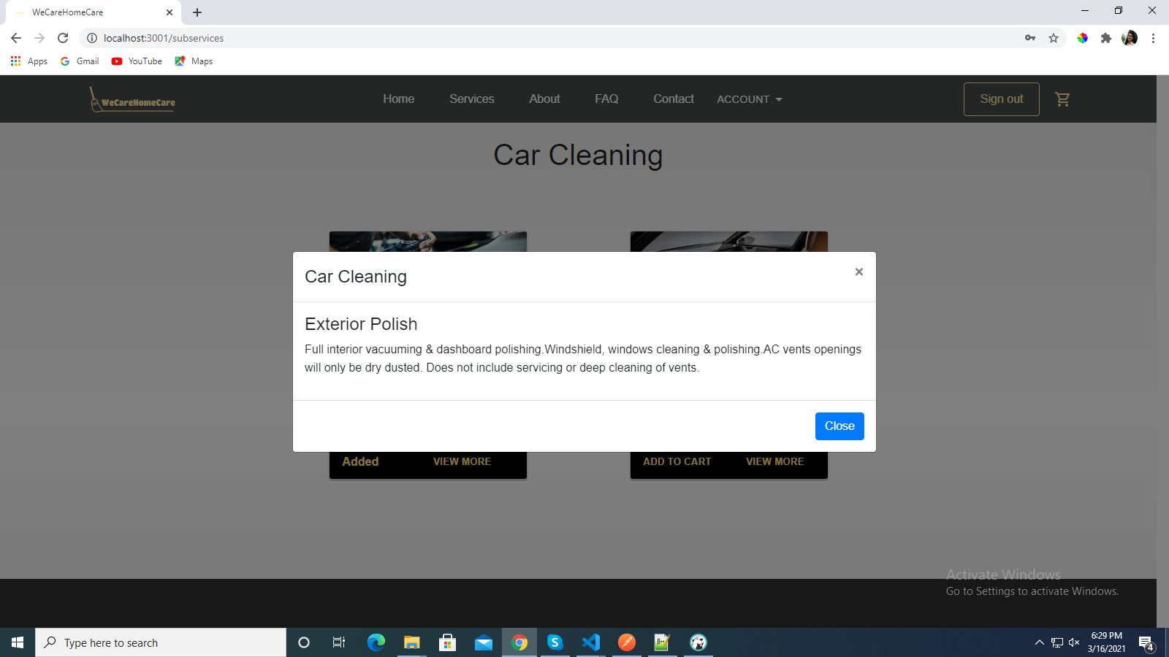
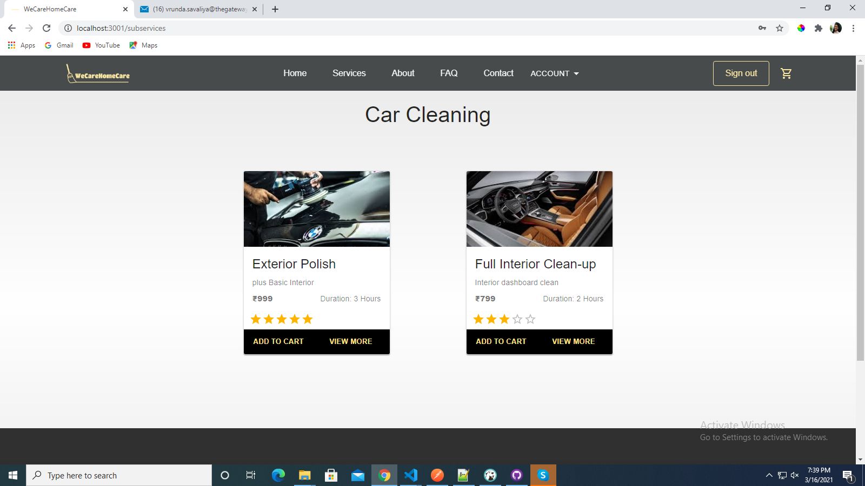
View Service Categories
CLICK ON VIEW MORE

Slide 13
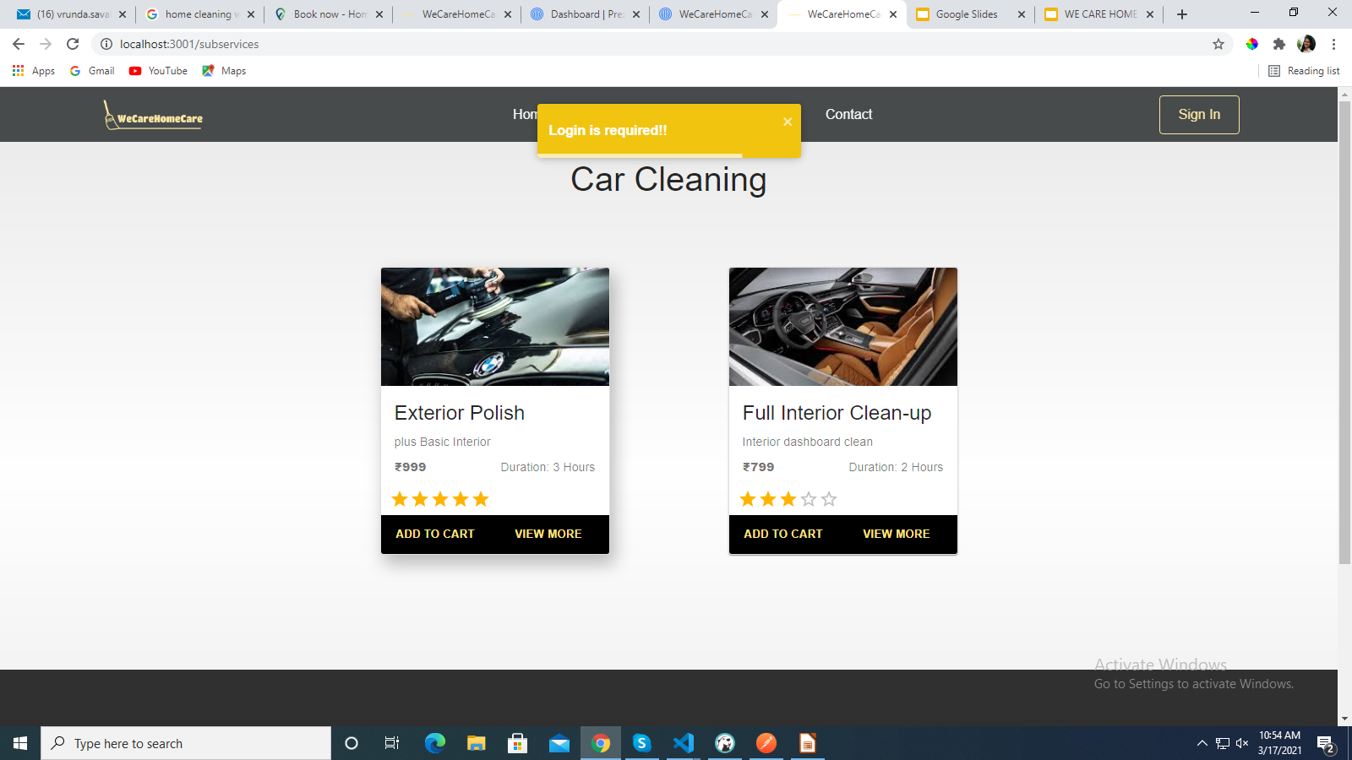
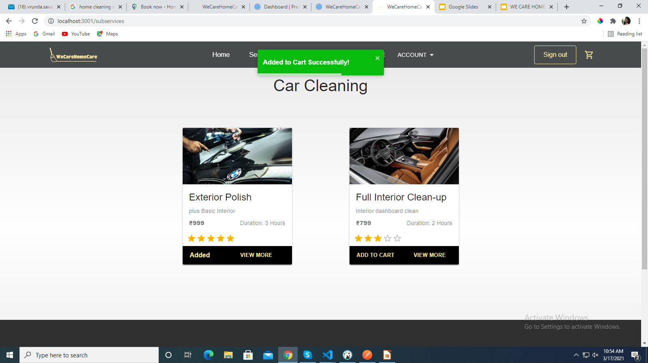
Add To Cart
CLICK ON ADD TO CART

Slide 14
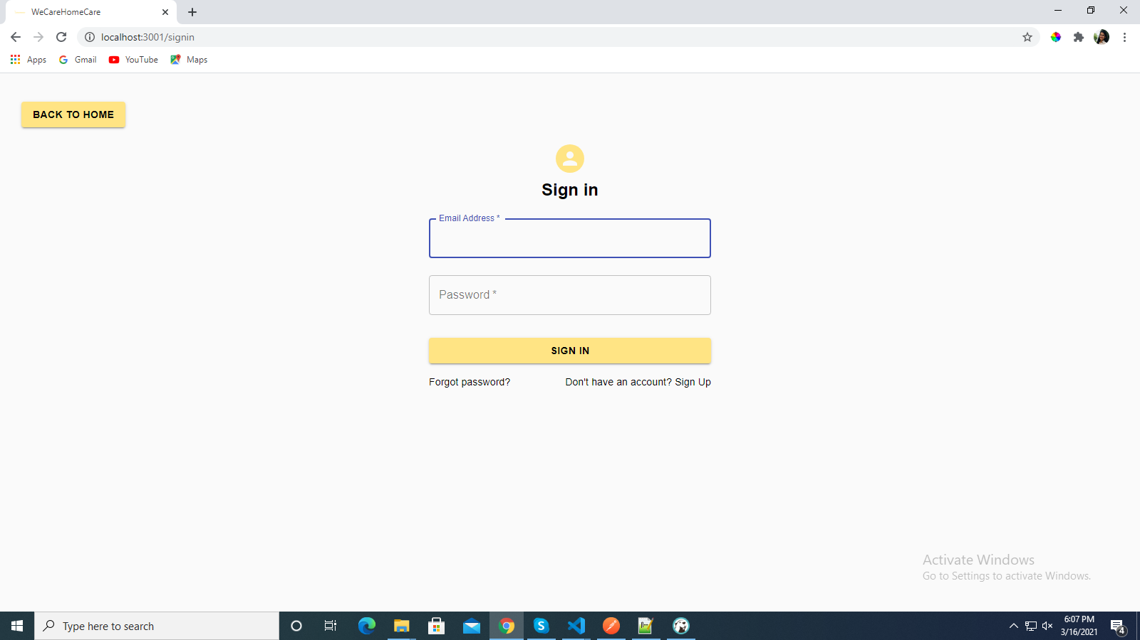
Sign In

Slide 15
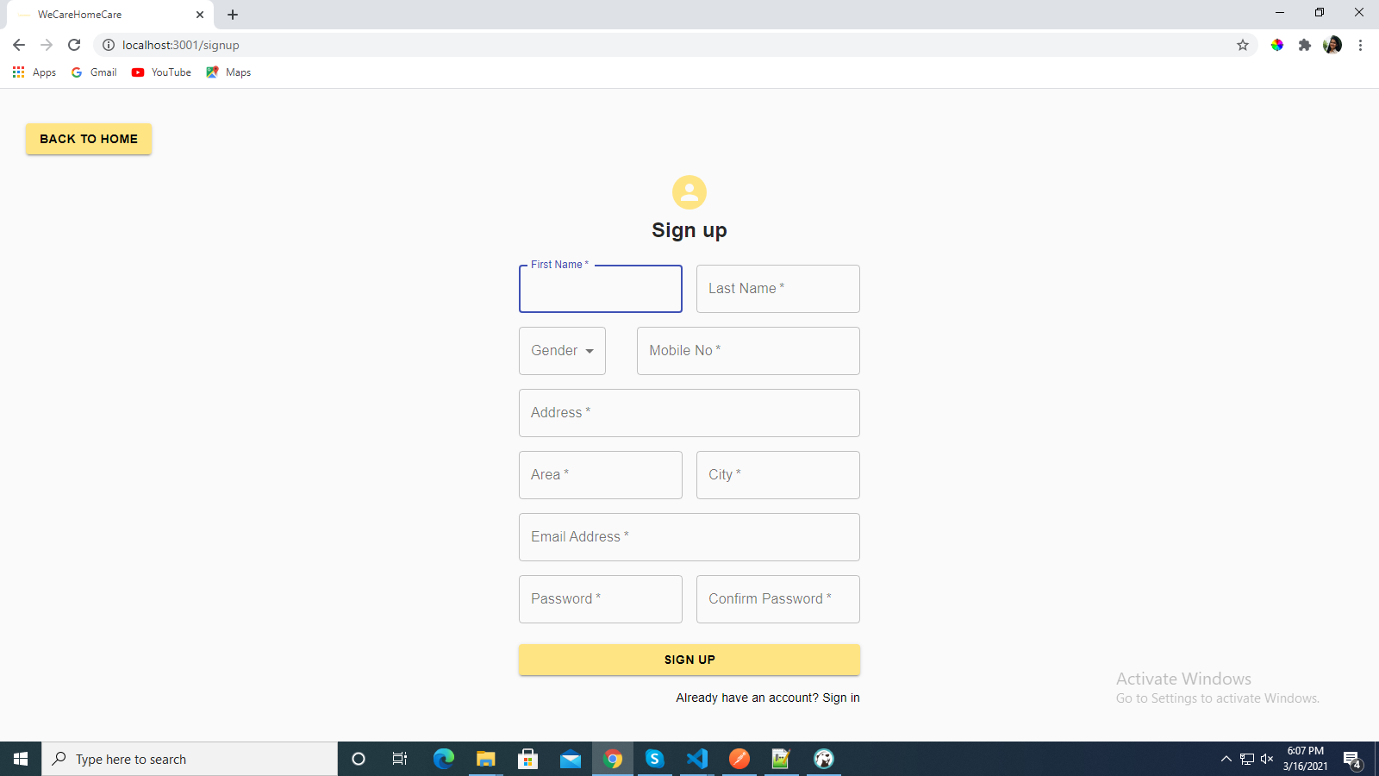
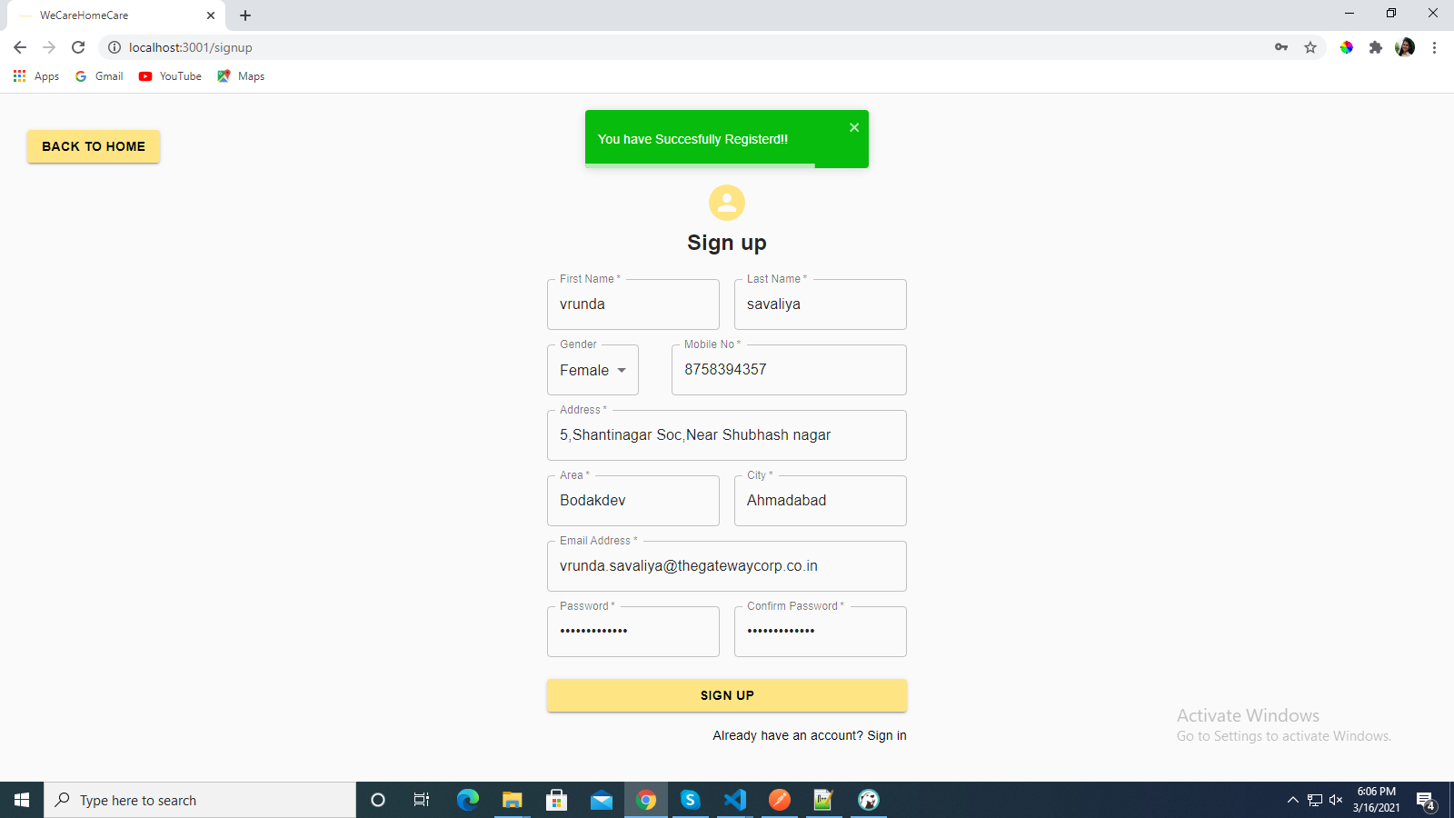
Sign Up

Slide 16
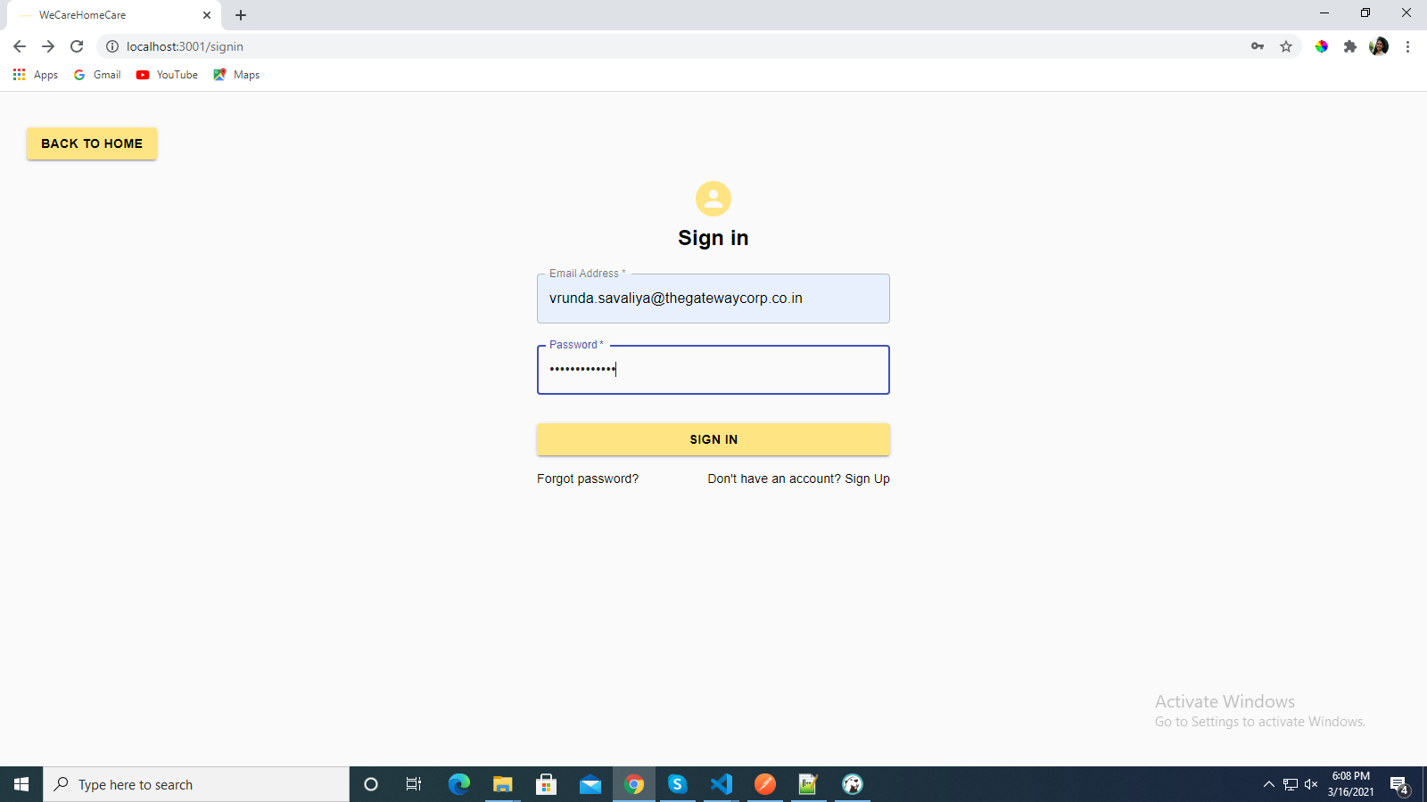
SIGN IN

Slide 17
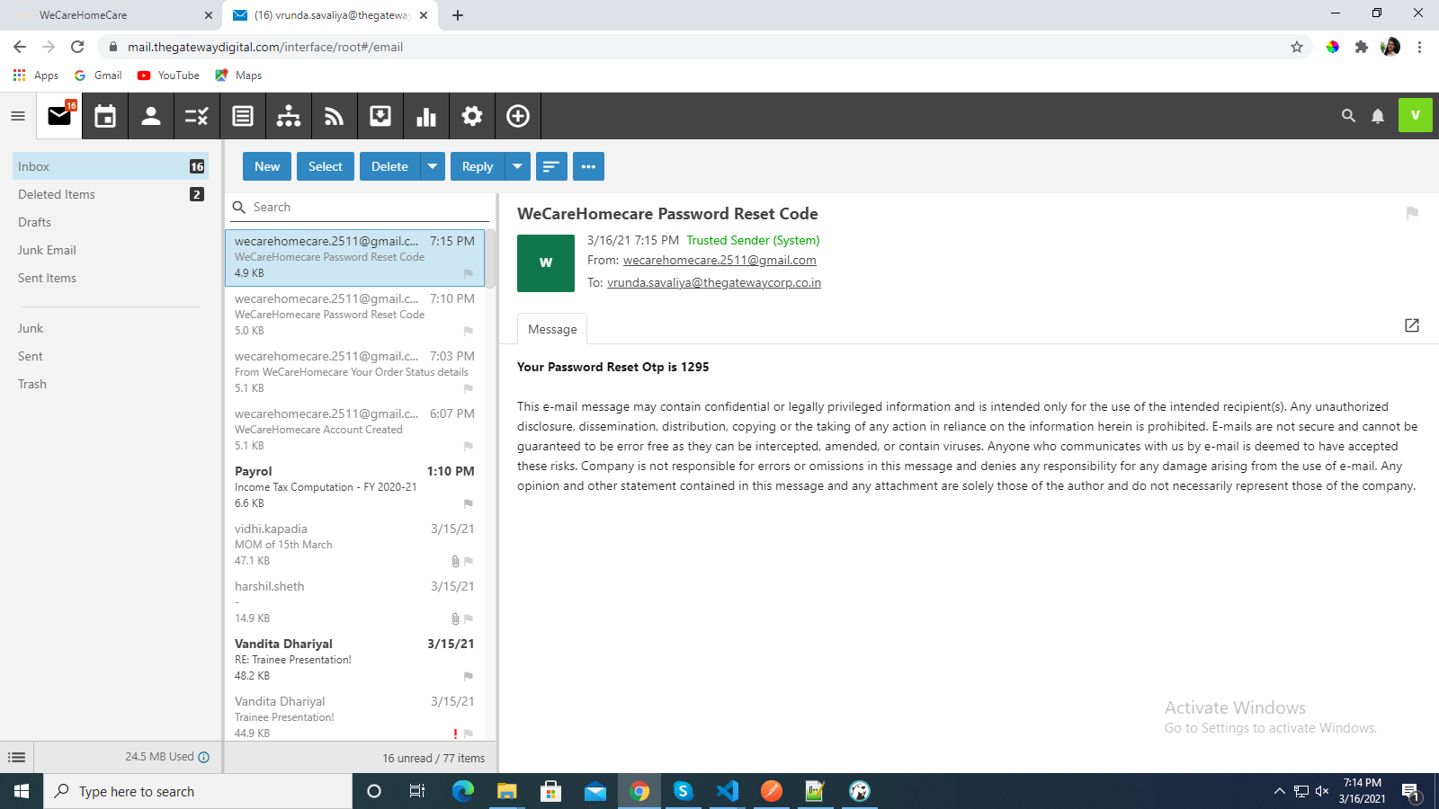
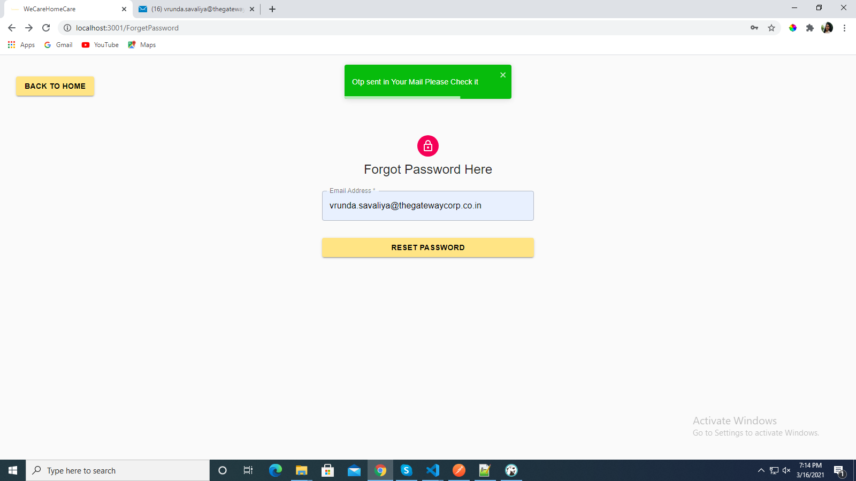
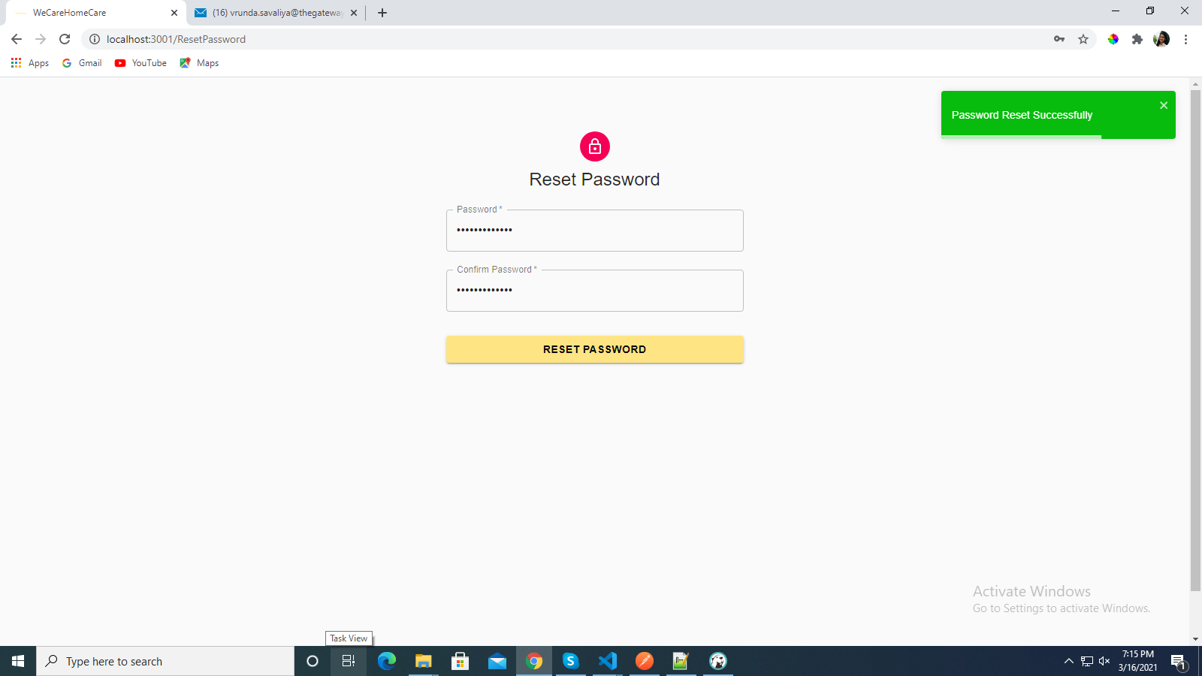
Forget Password

Slide 18
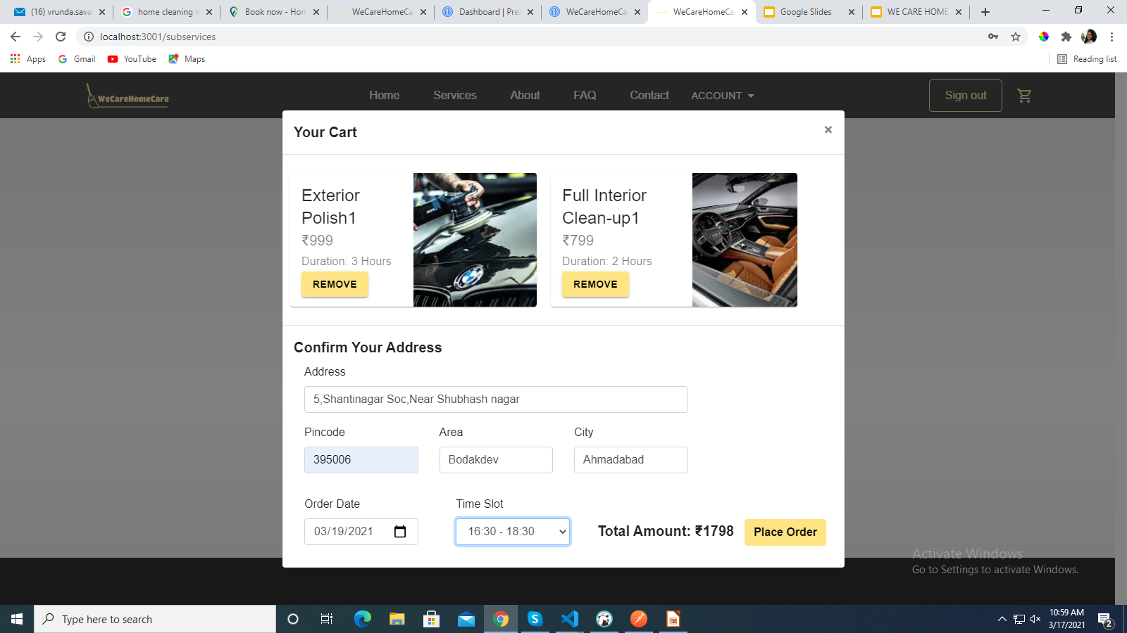
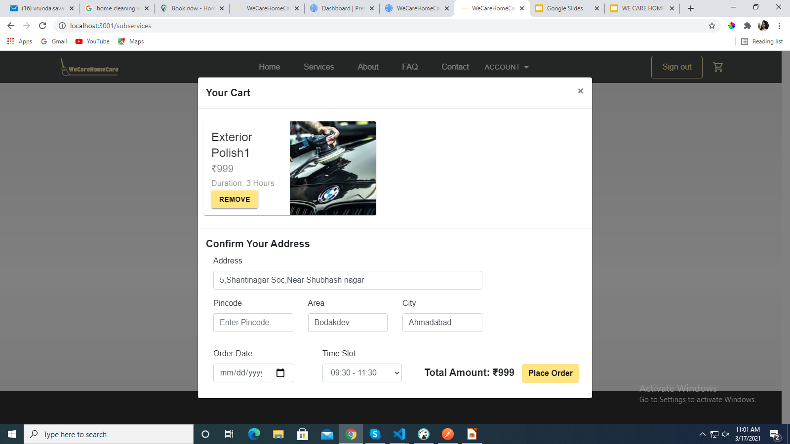
View Cart

Slide 19
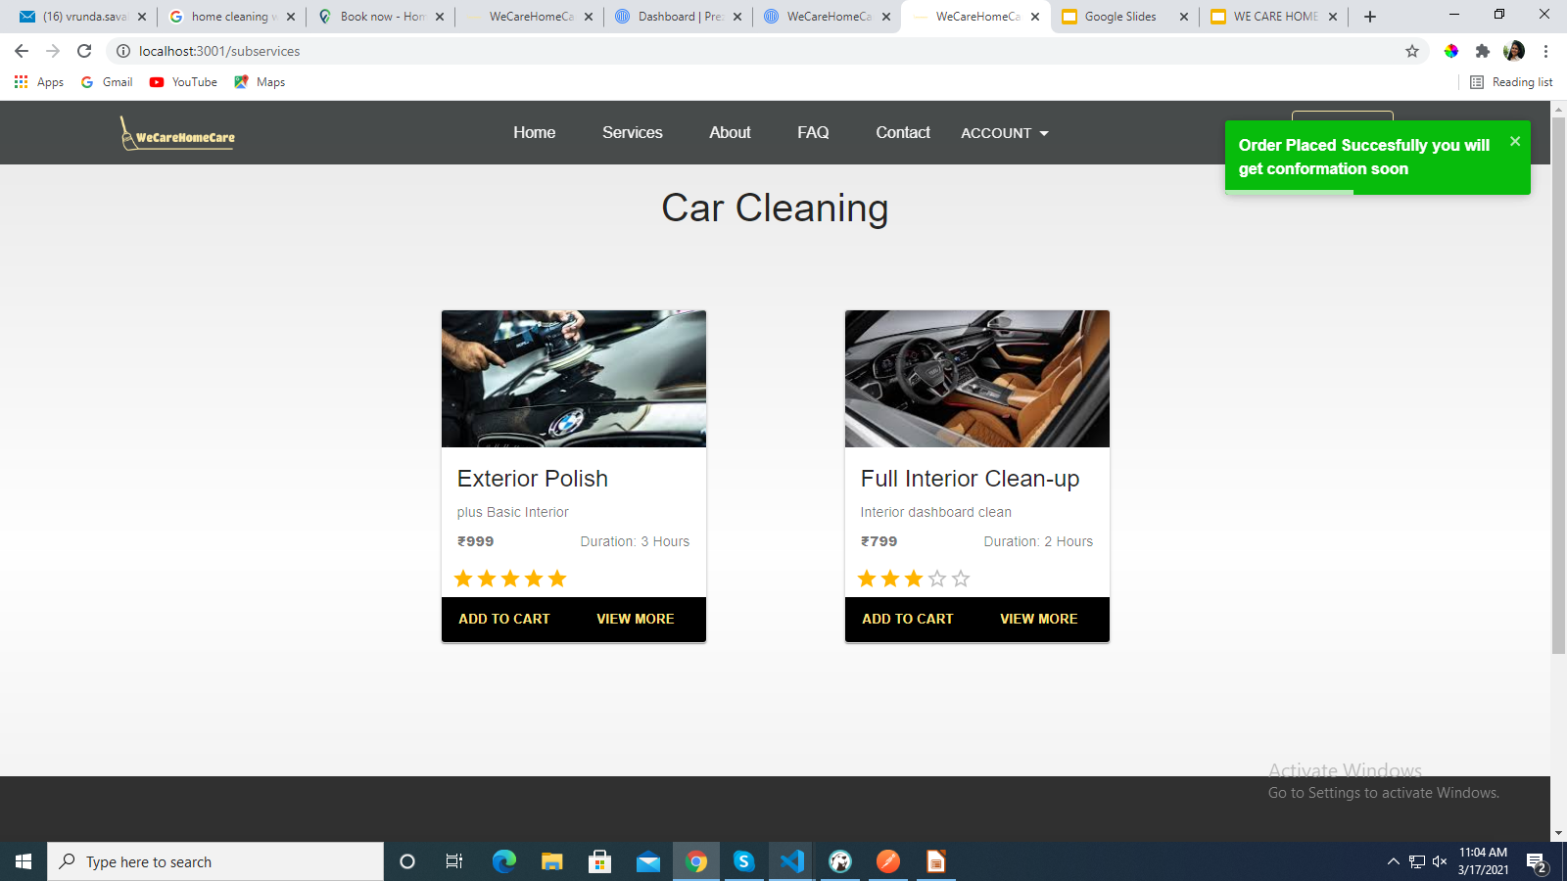
Place Order

Slide 20
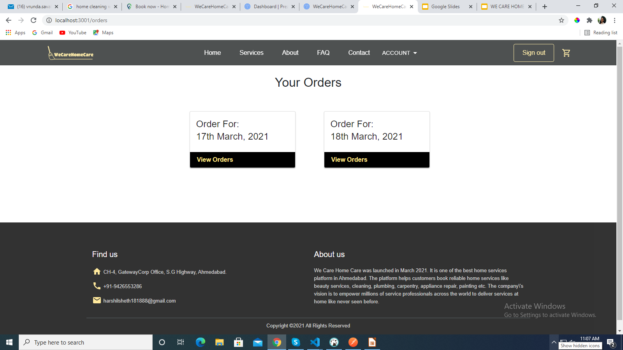
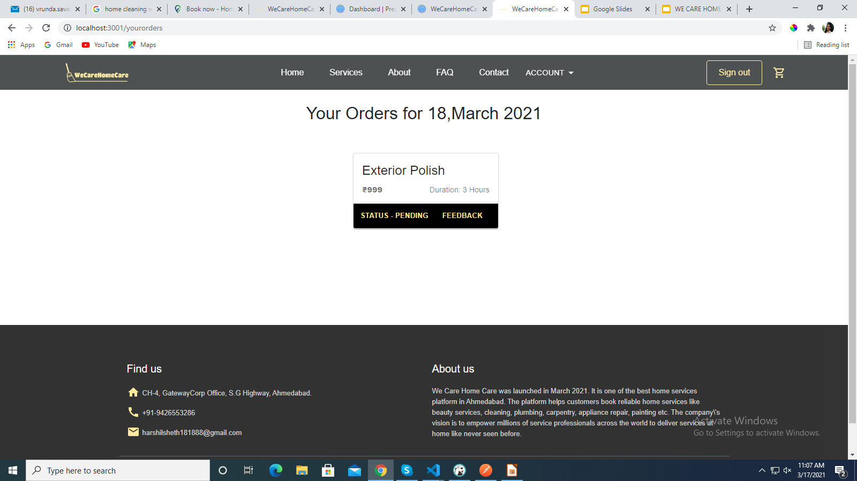
View Order

Slide 21
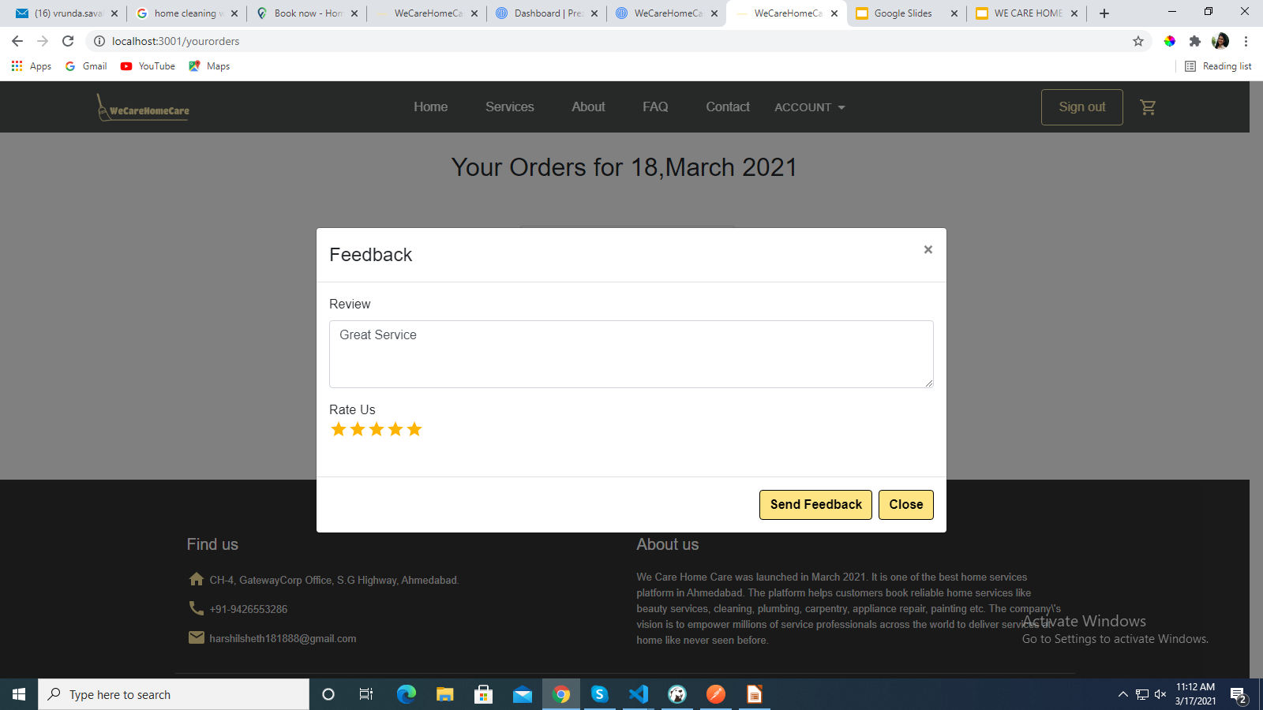
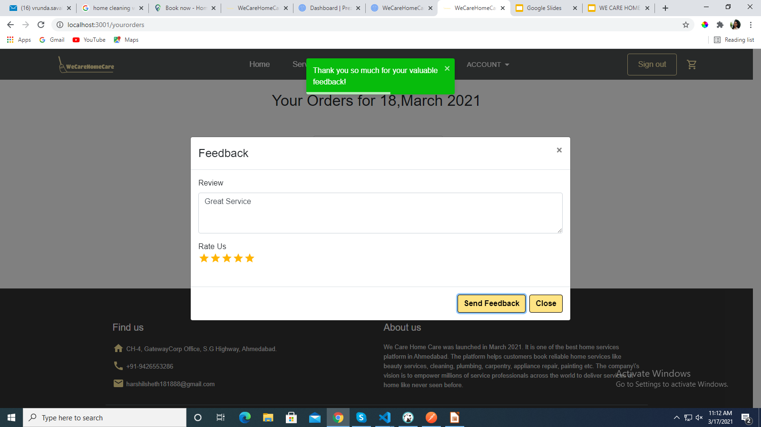
Give Feedback

Slide 22
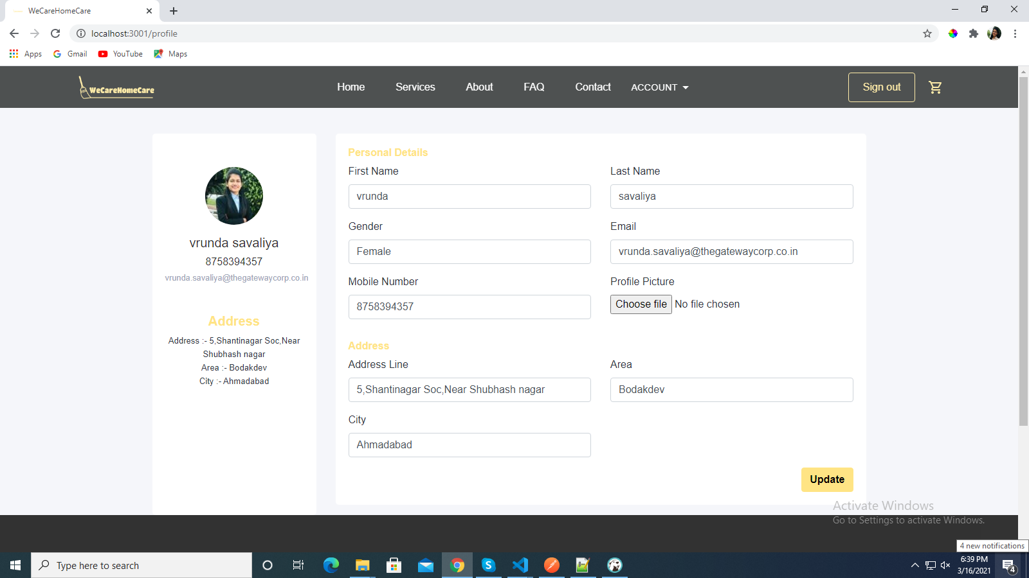
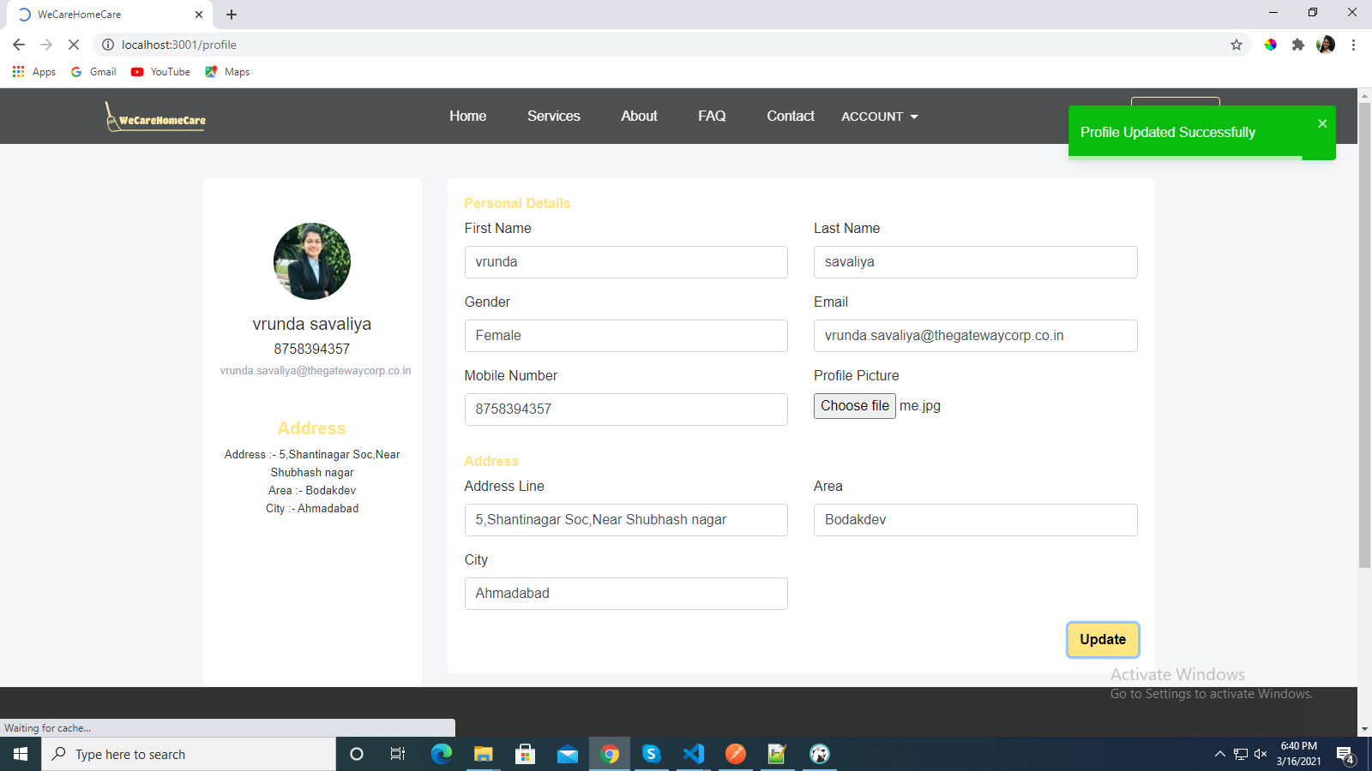
Profile

Slide 23
IMPLEMENTATION- ADMIN INTERFACE

Slide 24
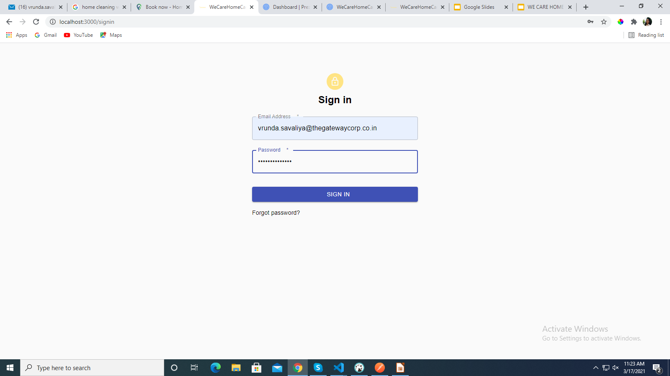
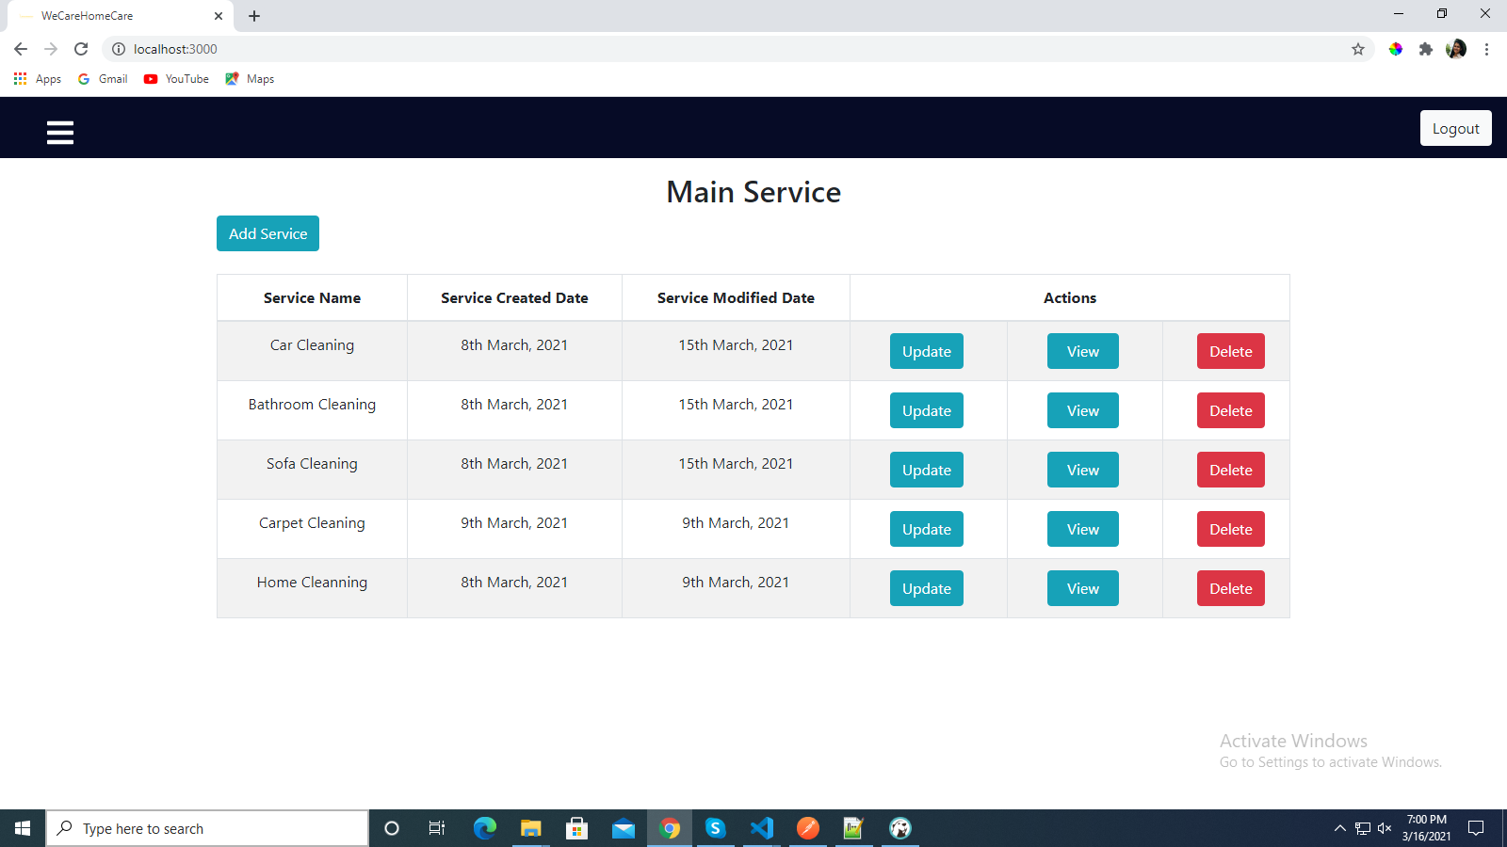
Manage Service

Slide 25
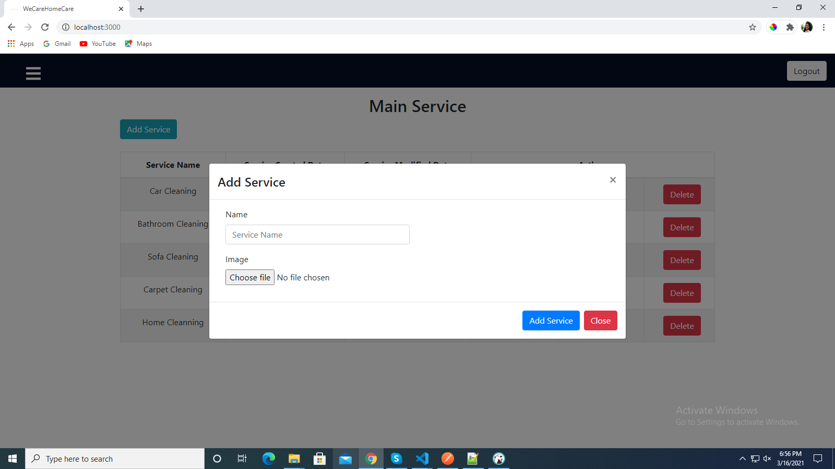
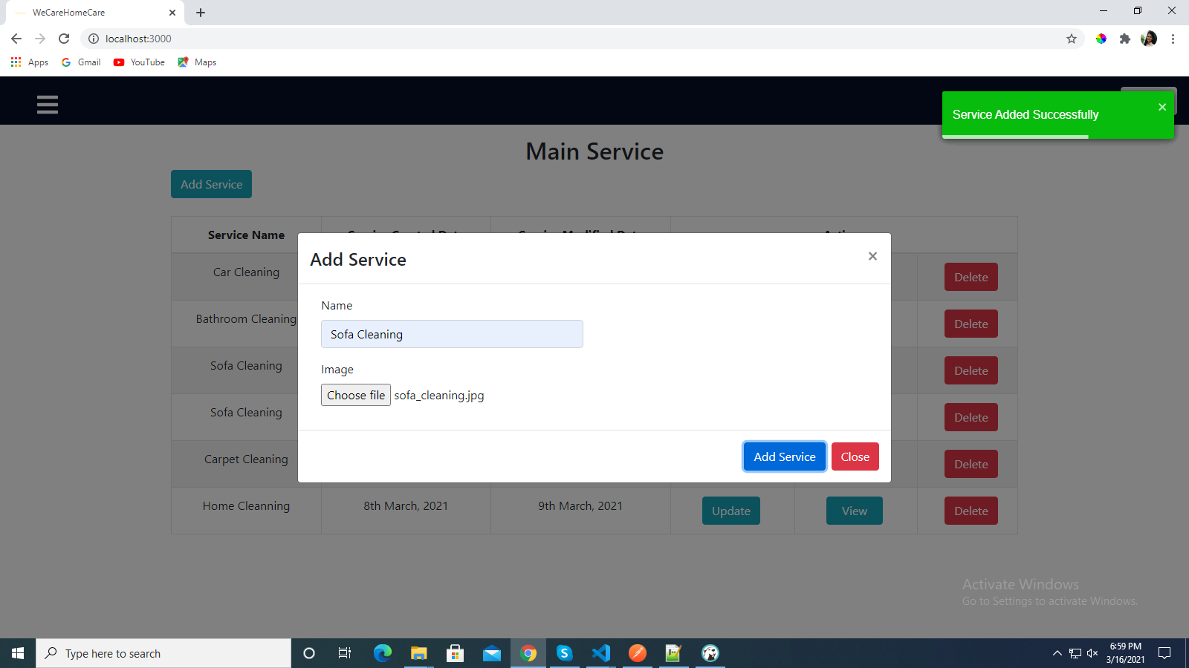
Add Service

Slide 26
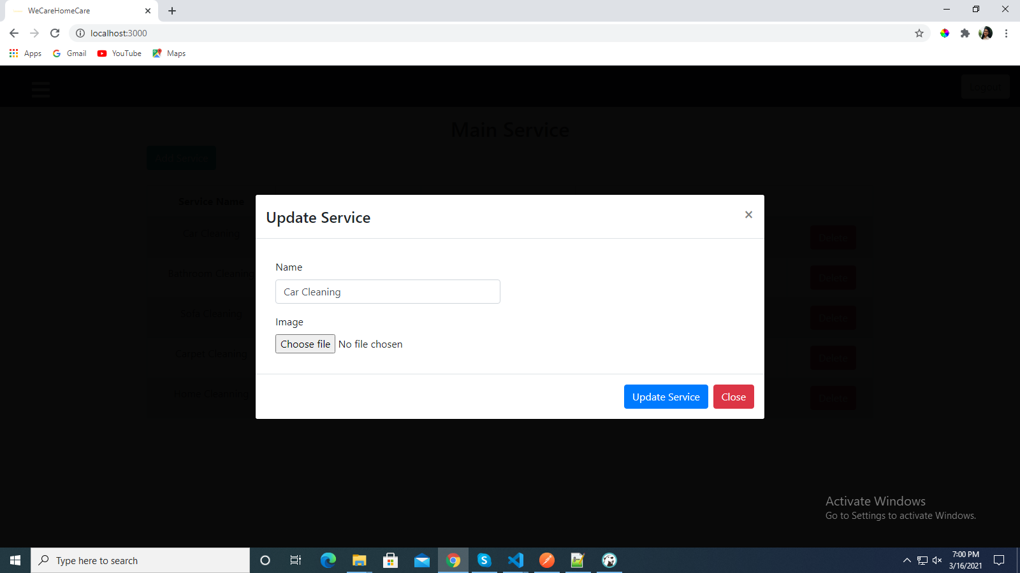
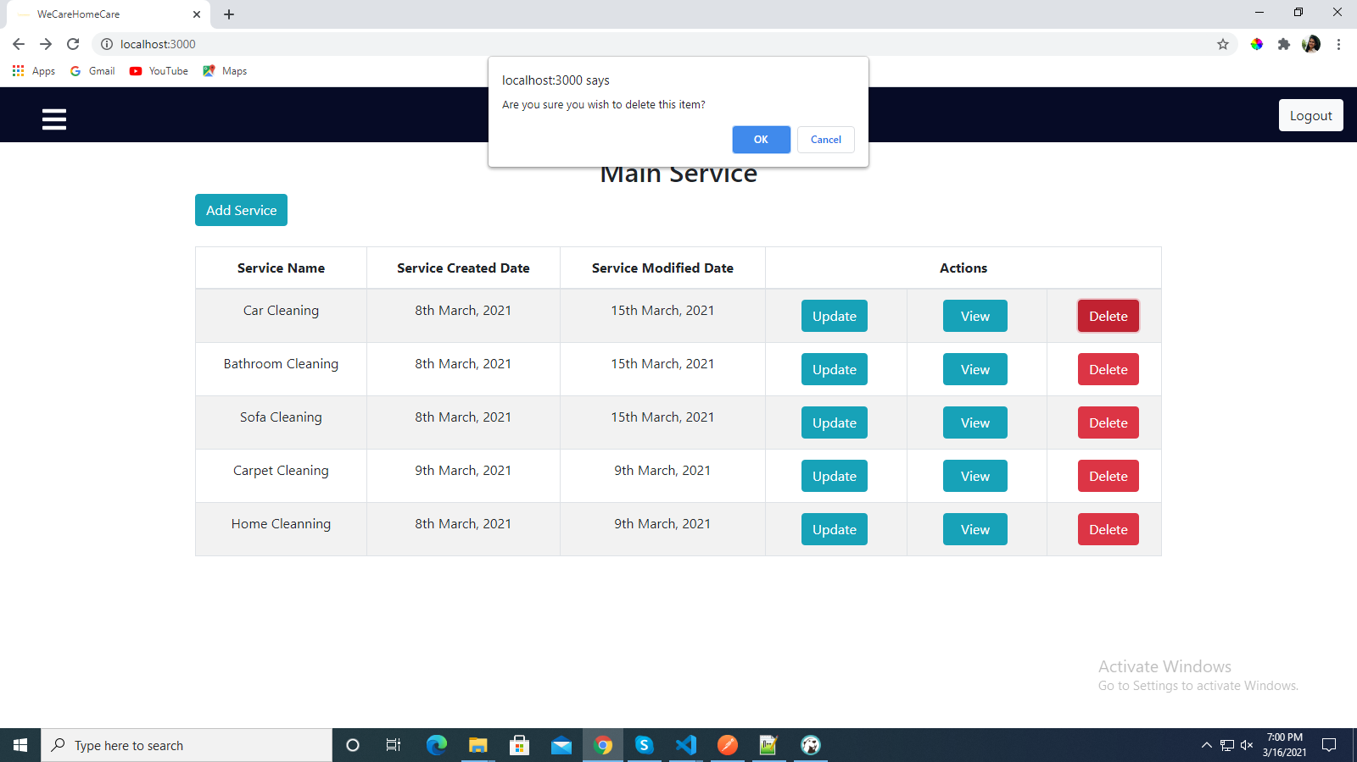
Update-Delete Service

Slide 27
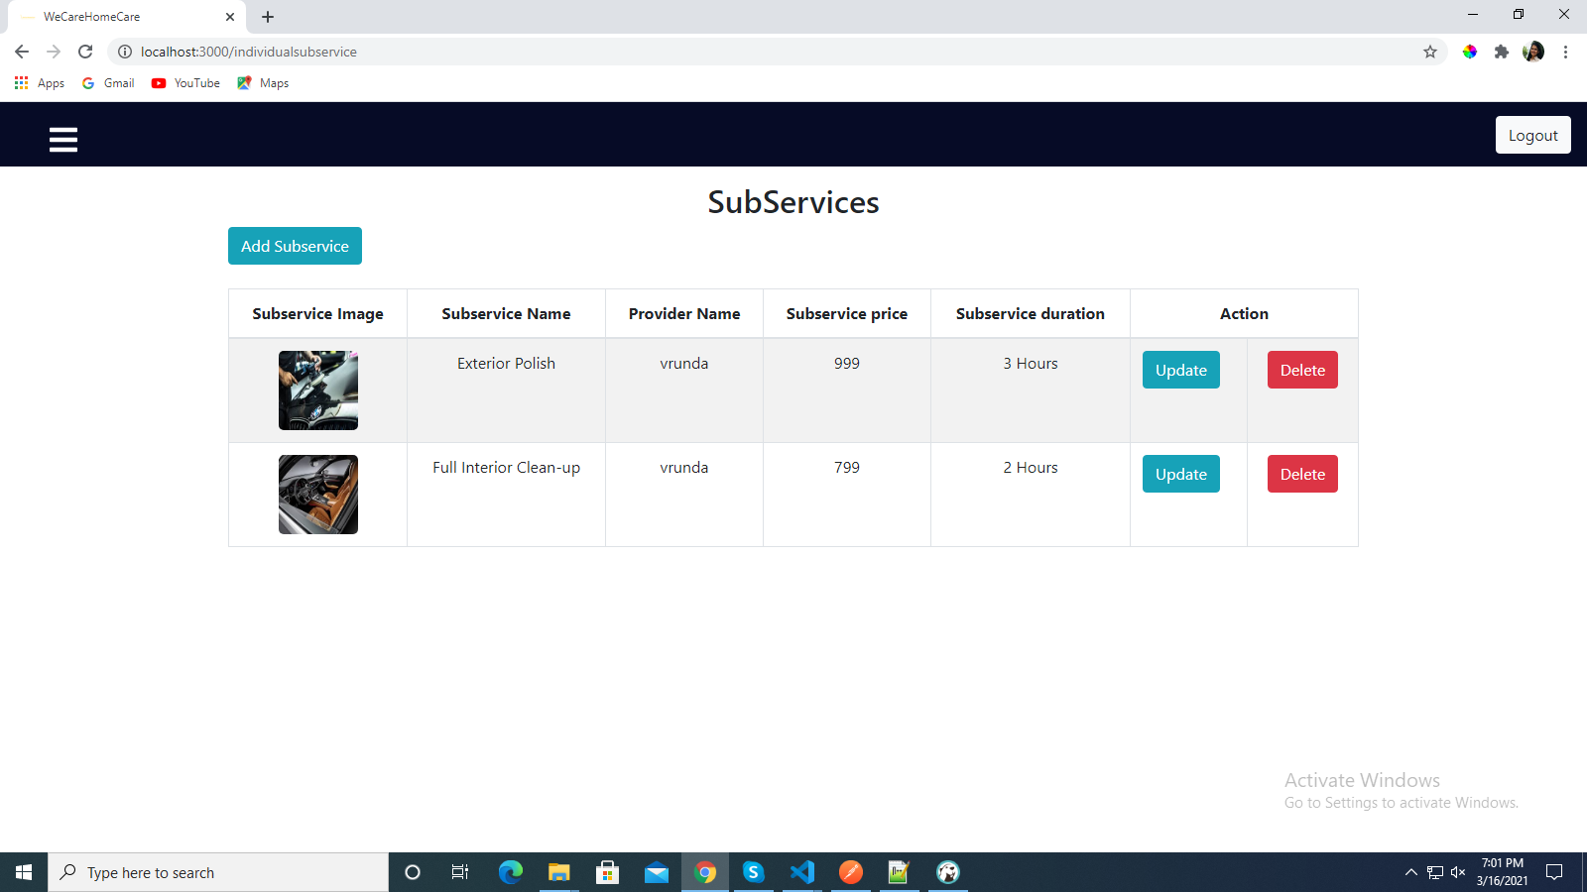
Manage Service Categories

Slide 28
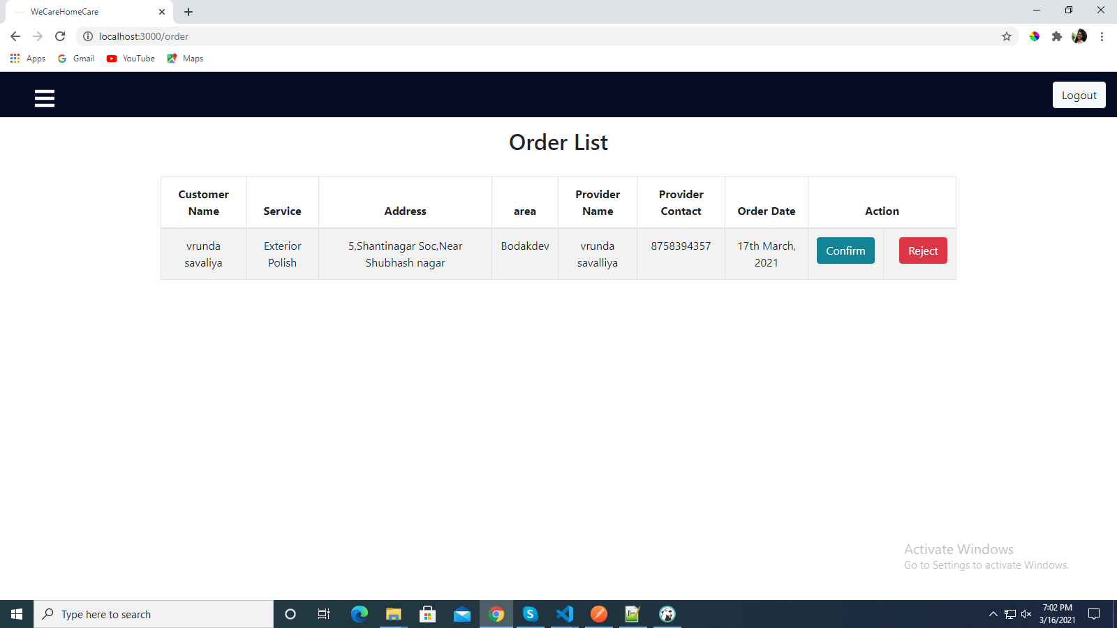
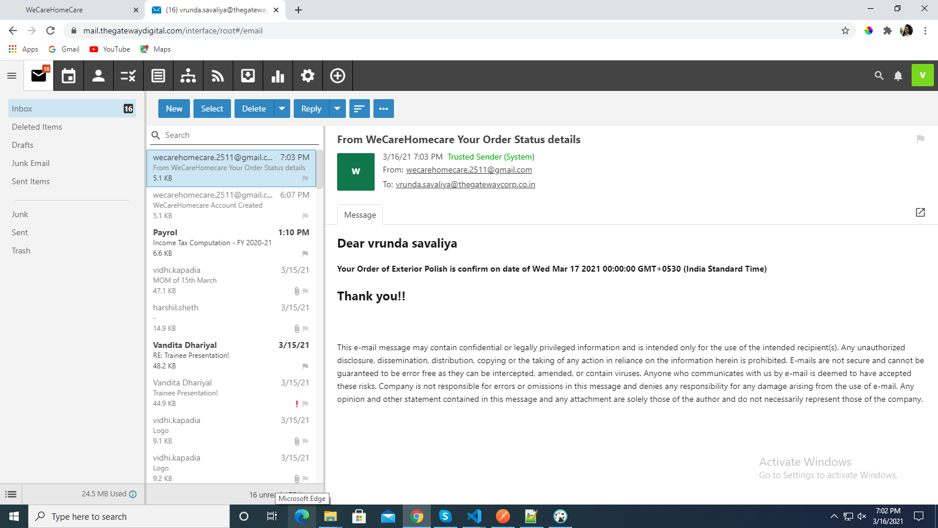
Manage Order

Slide 29
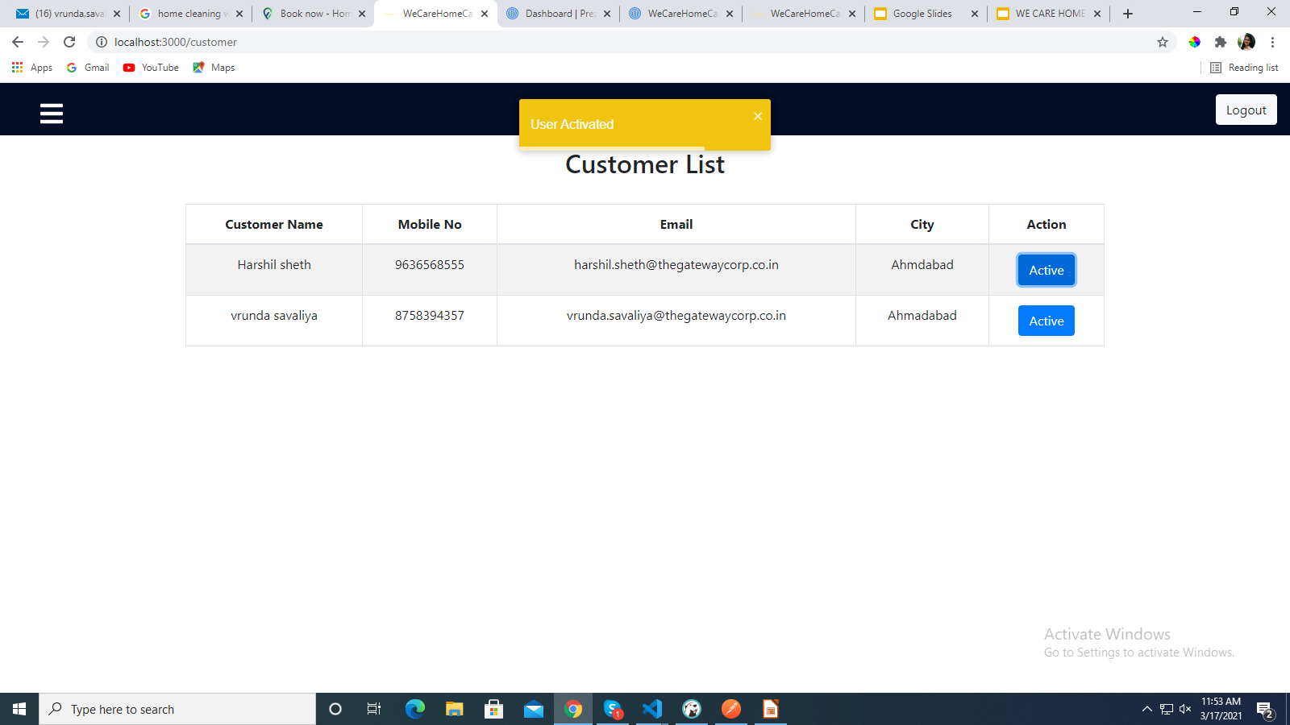
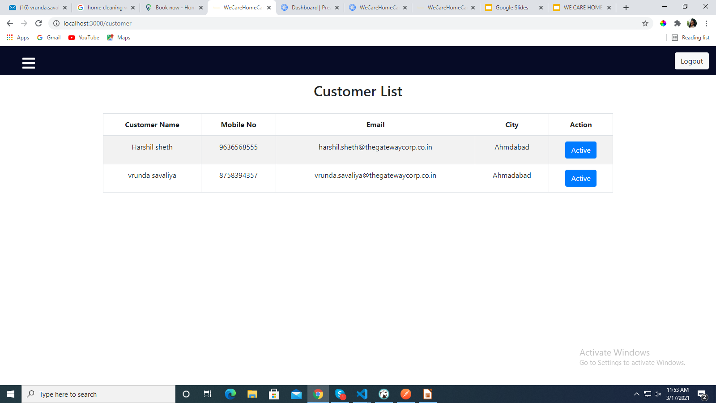
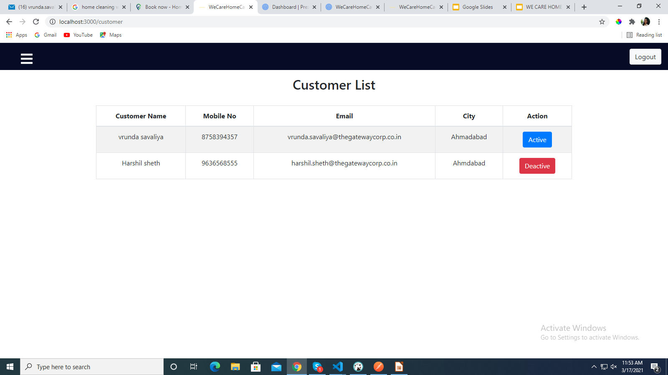
Manage Customer

Slide 30
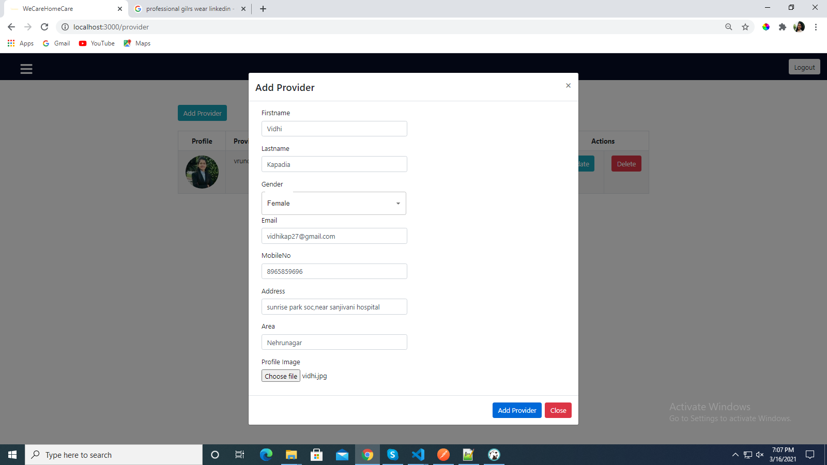
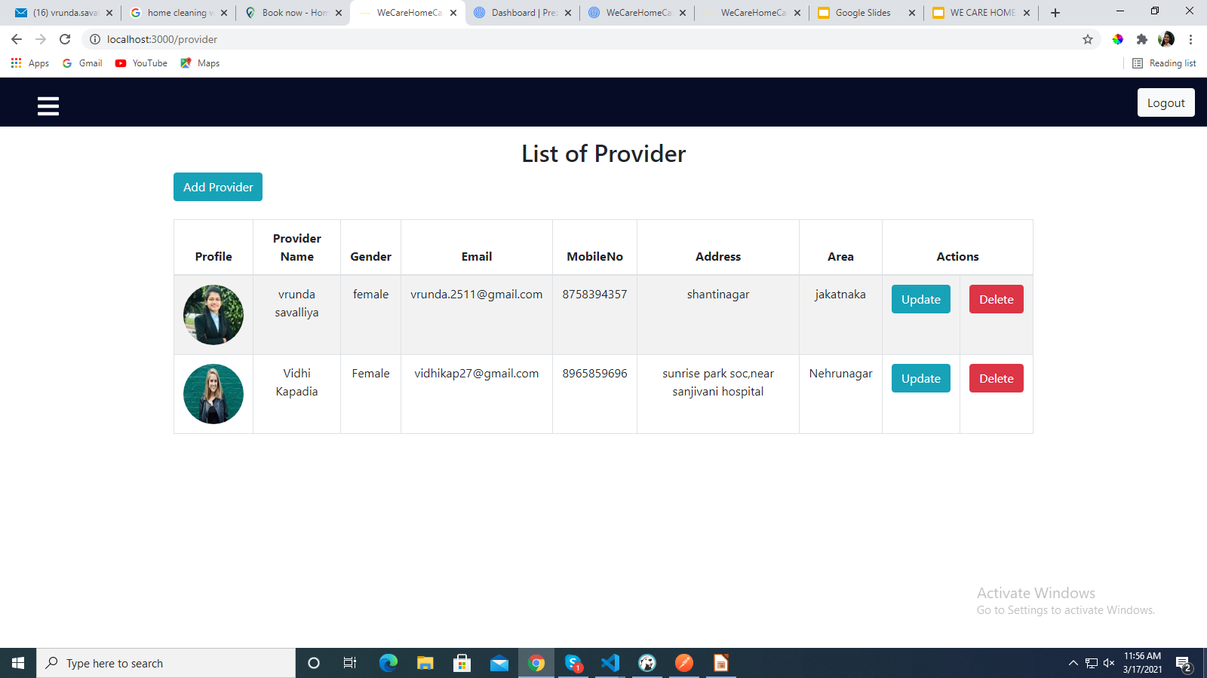
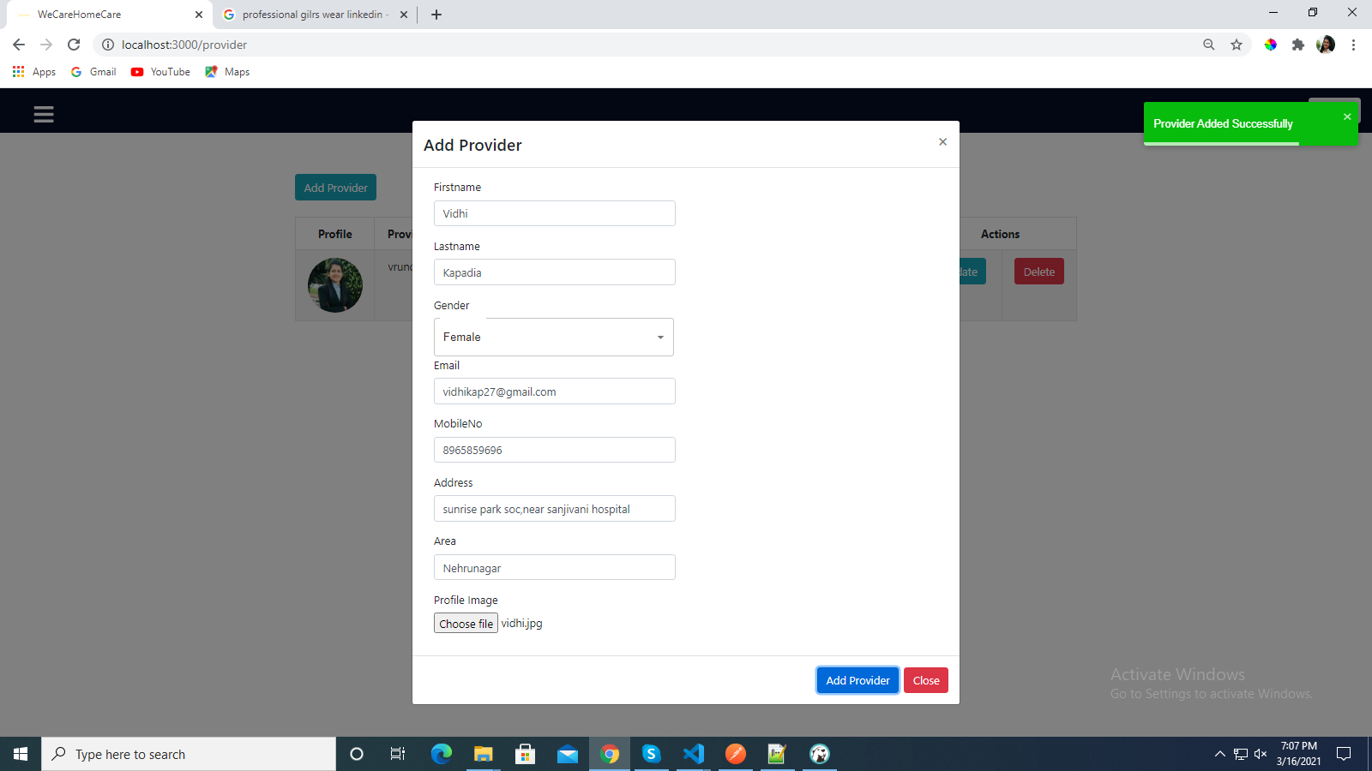
Manage Provider

Slide 31
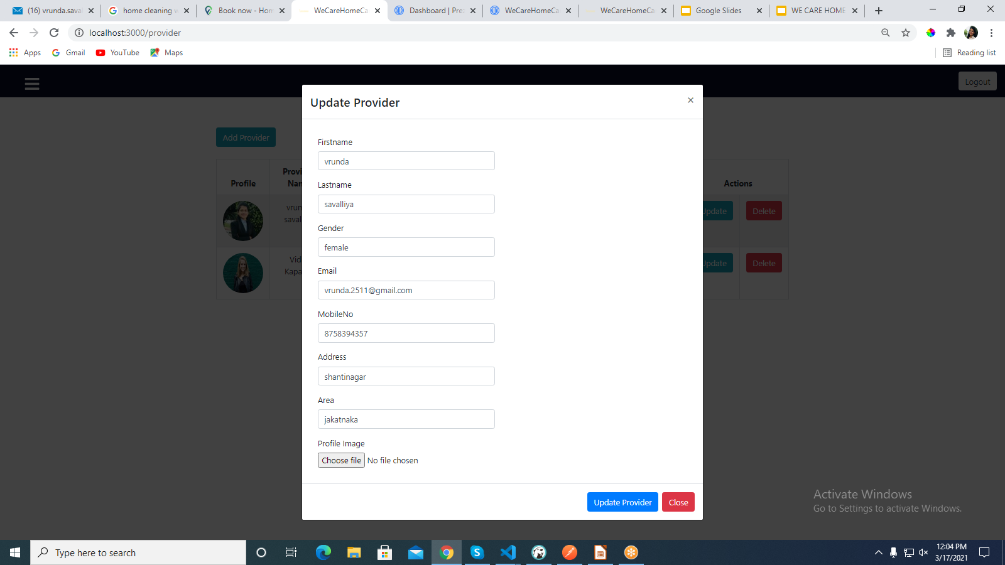
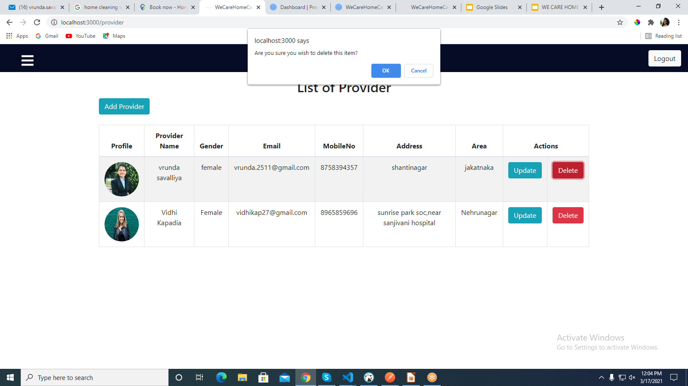
Update-Delete Provider

Slide 32
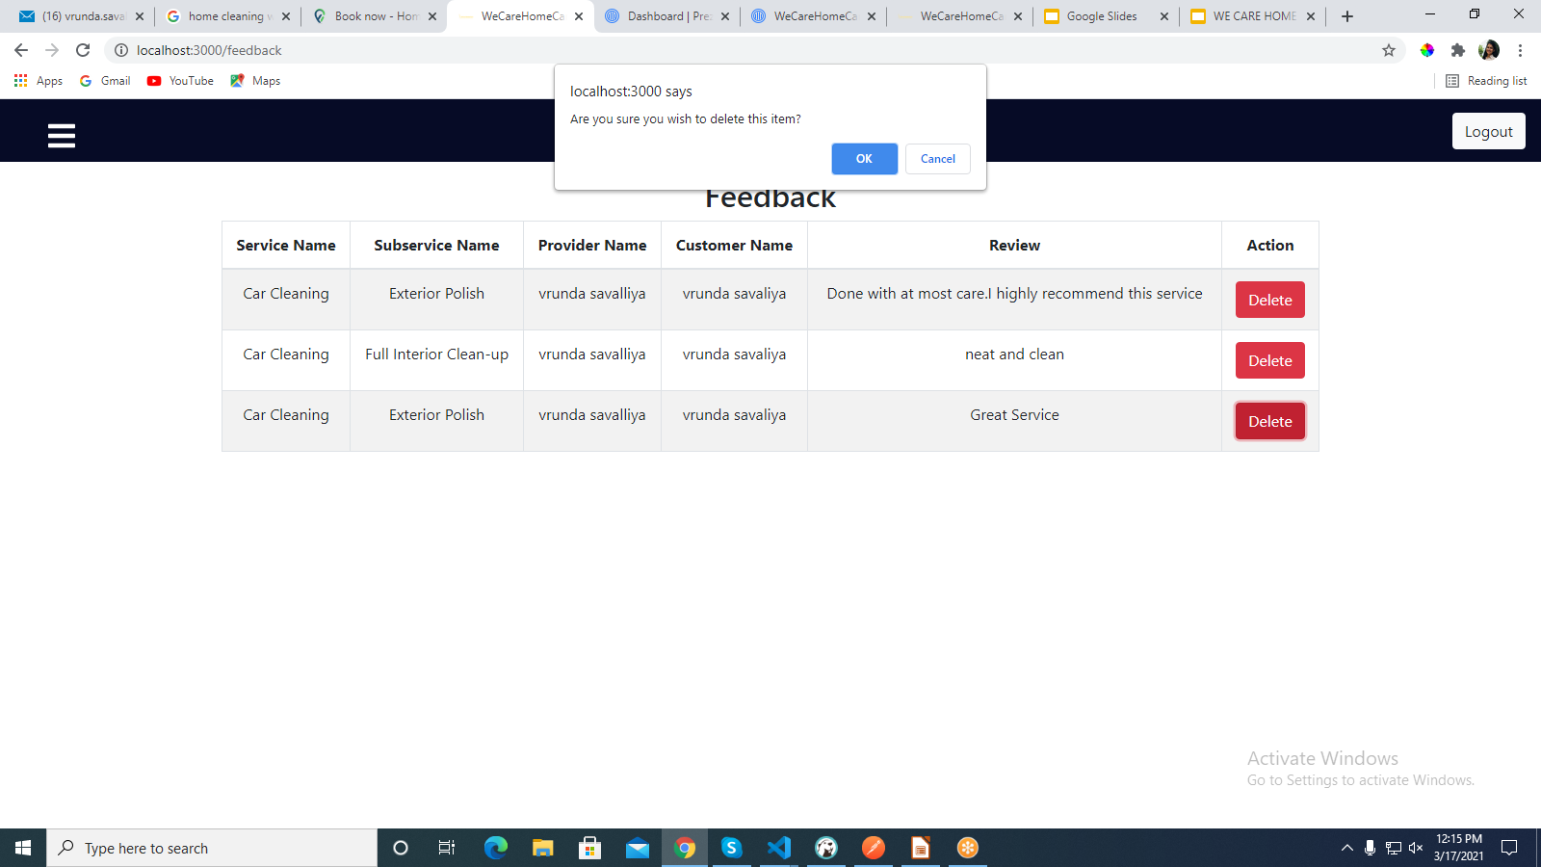
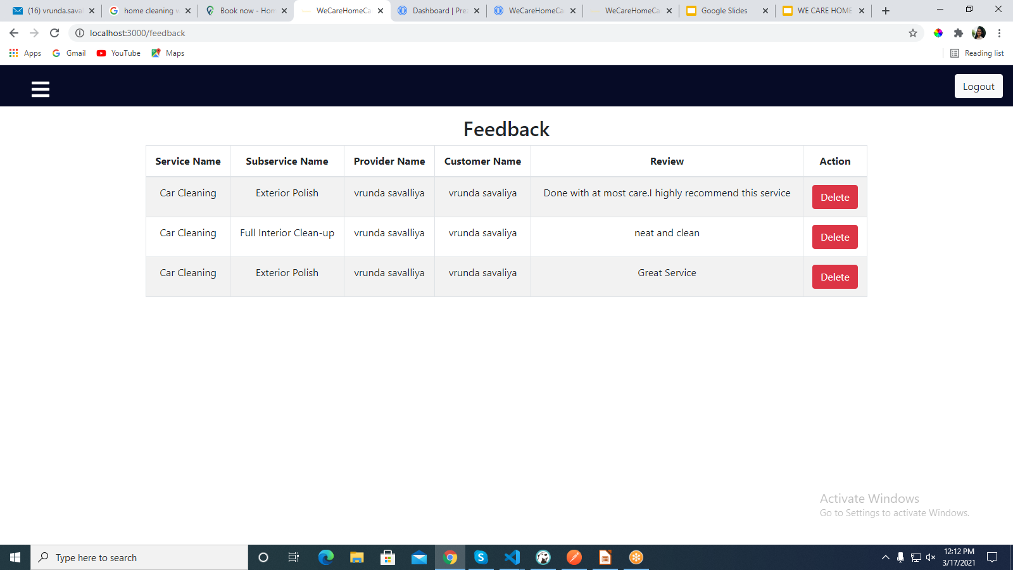
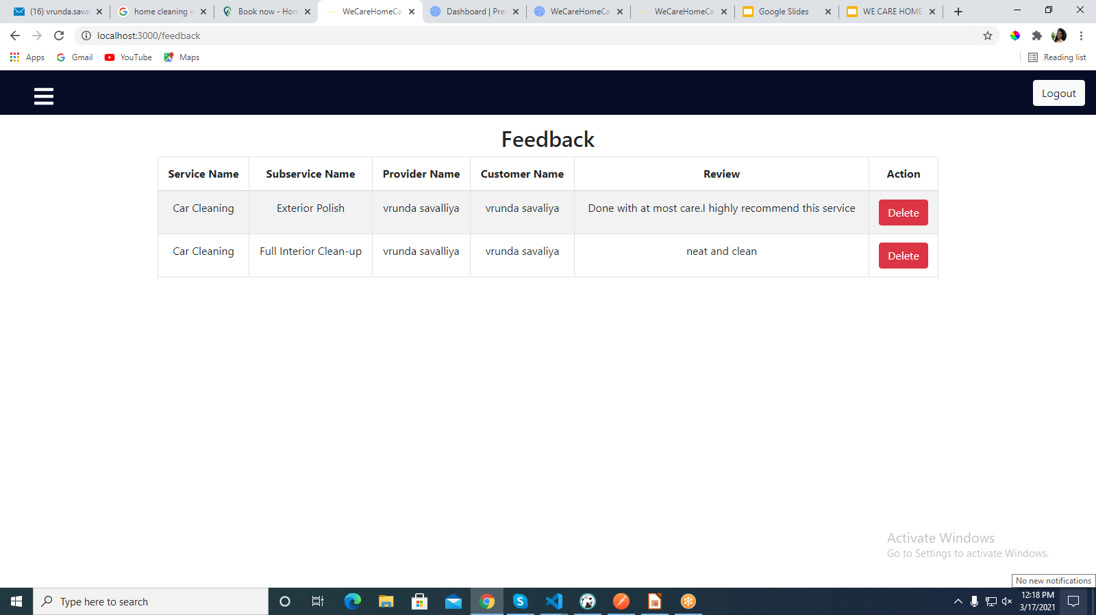
Manage Feedback

Slide 33
FUTURE ENHANCEMENT
In future, we will add Provider Dashboard in which they can able to add there services by their own.
We will provide online payment facility

Slide 34
THANK YOU!!

